Slide 1

UDPS 2133 Mathematical Programming
Topic 4:
Probabilistic Dynamic Programming

Slide 2
Deterministic dynamic programming
known with certainty
Probabilistic dynamic programming
Demand is known at the beginning of the problem
If unknown 

Slide 3
Current Stage Cost Uncertain, Next Period’s State Certain
For a price of $1/gallon, Safeco Supermarket chain has purchased 6 gallons of milk from a local dairy. Each gallon of milk is sold for $2/gallon. The dairy must buy back for 50¢/gallon any milk that is left at the end of the day. Allocate the 6 gallons of milk to the three stores so as to maximize the expected net daily profit earned from milk.
 | Store 1 |  |  | Store 2 |  |  | Store 3
Demand | 1 | 2 | 3 | 1 | 2 | 3 | 1 | 2 | 3
Probability | 0.6 | 0 | 0.4 | 0.5 | 0.1 | 0.4 | 0.4 | 0.3 | 0.3

Slide 4
Current Stage Cost Uncertain, Next Period’s State Certain
 | Store 1 |  |  | Store 2 |  |  | Store 3
Demand | 1 | 2 | 3 | 1 | 2 | 3 | 1 | 2 | 3
Probability | 0.6 | 0 | 0.4 | 0.5 | 0.1 | 0.4 | 0.4 | 0.3 | 0.3
r_{t}(g_{t}) = expected revenue earned from g_{t} gallons assigned to store t
f_{t}(x) = maximum expected revenue earned from x gallons assigned to stores t

Slide 5
Current Stage Cost Uncertain, Next Period’s State Certain
 | Store 1 |  |  | Store 2 |  |  | Store 3
Demand | 1 | 2 | 3 | 1 | 2 | 3 | 1 | 2 | 3
Probability | 0.6 | 0 | 0.4 | 0.5 | 0.1 | 0.4 | 0.4 | 0.3 | 0.3
Assign 3 gallon to store 3
Demand = 1, revenue + left over paid = 0.4 × (2 + 0.5+ 0.5) = 1.20
Demand = 2, revenue + left over paid = 0.3 × (2 + 2 + 0.5) = 1.35
Demand = 3, sold out all 3 = 0.3 × (2 + 2 + 2) = 1.80
Total : 4.35
Assign 2 gallon to store 3
Demand = 1, revenue + left over paid = 0.4 × (2 + 0.5) = 1.0
Demand ≥ 2, sold out all 2 = (0.3 + 0.3)×(2 + 2) = 2.4
Total : 3.4
f₃(x) = r₃(x)
Revenue
Store 3 | Store 2 | Store 1
r₃(0) = 0 | r₂(0) = 0 | r₁(0) = 0
r₃(1) = 2 | r₂(1) = 2 | r₁(1) = 2
r₃(2) = 3.40 | r₂(2) = 3.25 | r₁(2) = 3.10
r₃(3) = 4.35 | r₂(3) = 4.35 | r₁(3) = 4.20

Slide 6
Current Stage Cost Uncertain, Next Period’s State Certain
 | Store 1 |  |  | Store 2 |  |  | Store 3
Demand | 1 | 2 | 3 | 1 | 2 | 3 | 1 | 2 | 3
Probability | 0.6 | 0 | 0.4 | 0.5 | 0.1 | 0.4 | 0.4 | 0.3 | 0.3
Assign 3 gallon to store 2
Demand = 1, revenue + left over paid = 0.5 × (2 + 0.5 + 0.5) = 1.50
Demand = 2, revenue + left over paid = 0.1 × (2 + 2 + 0.5) = 0.45
Demand = 3, sold out all 3 = 0.4 × (2 + 2 + 2) = 2.40
Total : 4.35
Revenue
Store 3 | Store 2 | Store 1
r₃(0) = 0 | r₂(0) = 0 | r₁(0) = 0
r₃(1) = 2 | r₂(1) = 2 | r₁(1) = 2
r₃(2) = 3.40 | r₂(2) = 3.25 | r₁(2) = 3.10
r₃(3) = 4.35 | r₂(3) = 4.35 | r₁(3) = 4.20

Slide 7
Current Stage Cost Uncertain, Next Period’s State Certain
Store 2 | Store 3
r₂(0) = 0 | r₃(0) = 0
r₂(1) = 2 | r₃(1) = 2
r₂(2) = 3.25 | r₃(2) = 3.40
r₂(3) = 4.35 | r₃(3) = 4.35
f₂(0) = r₂(0) + f₃(0 – 0) = 0 g₂(0) = 0

Slide 8
Current Stage Cost Uncertain, Next Period’s State Certain
No point assigning 0 to store 2 ⇒ left 4 gallons available to store 3
Min assign 2 gallons to store 2 so that max 3 gallons to store 3
f₂(6) = r₂(3) + f₃(6 – 3) = 4.35 + 4.35 = 8.70* g₂(6) = 3

Slide 9
Current Stage Cost Uncertain, Next Period’s State Certain
1 gallon → Store 1
5 gallon → Store 2 & 3 ⇒ 3 gallon → store 2
2 gallon → Store 3
or
2 gallon → Store 1
4 gallon → Store 2 & 3 ⇒ 2 gallon → store 2
2 gallon → Store 3

Slide 10
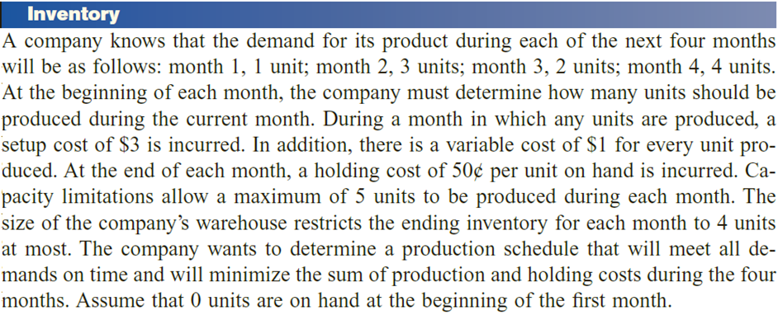
Probabilistic Inventory Model
=====================================
=
=
=
=
=
Each period demand = 1 or 2 units (equally likely)
Production cost, c(x) = 3 + 2x, max 4 units
Holding cost = $1
Ending inventory max 3 units, end of period 3, sold at $2/unit
Beginning inventory = 1 unit

Slide 11
Probabilistic Inventory Model
Each period demand = 1 or 2 units (equally likely)
Production cost, c(x) = 3 + 2x, max 4 units
Holding cost = $1
Ending inventory max 3 units, end of period 3, sold at $2/unit
Beginning inventory = 1 unit
Minimize cost = expected production cost + expected holding cost − expected salvage value
Stage3:
Cost, f₃(i) = min_{x} {c(x) + 0.5(1)(i + x – 1) + 0.5(1)(i + x – 2)
− 0.5(2)(i + x – 1) − 0.5(2)(i + x – 2) }
= min_{x} {c(x) + i + x – 1.5 − (2i + 2x – 3)}
** end of period 3: i + x – 1 ≤ 3 ⇒ x ≤ 4 − i
Holding cost (inventory i + produce x − 1 or 2 demand)
Ending inventory sold out at $2

Slide 12
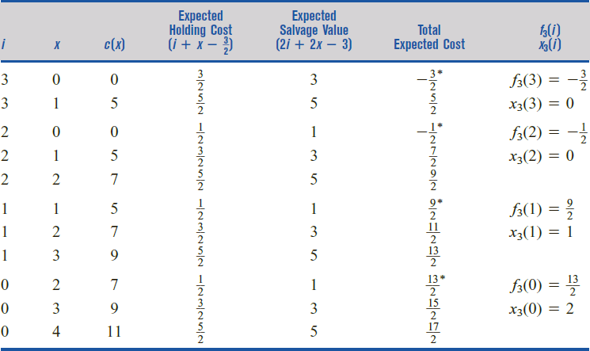
Probabilistic Inventory Model
f₃(i) = min_{x} {c(x) + i + x – 1.5 − (2i + 2x – 3)}

Slide 13
Probabilistic Inventory Model
Stage 2 & 1:
Cost, f_{t}(i) = min_{x} {c(x) + 0.5(1)(i + x – 1) + 0.5(1)(i + x – 2)
+ 0.5f_{t+1}(i + x – 1) + 0.5f_{t+1}(i + x – 2) }
= min_{x} {c(x) + i + x –1.5 + 0.5[f_{t+1}(i + x – 1) + f_{t+1}(i + x – 2)]
Produce x = 0, 1, …, 4, (demand) 2 − i ≤ x ≤ 4 − i (on hand)
Holding cost (inventory i + produce x − 1 or 2 demand)
Cost at next stage with this ending inventory as beginning inventory

Slide 14
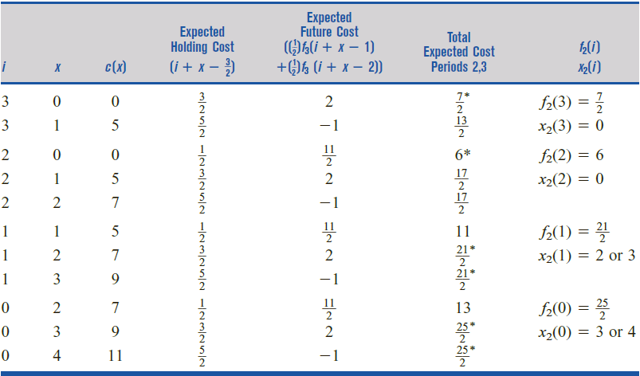
Probabilistic Inventory Model
f₂(i) = min_{x} {c(x) + i + x –1.5 + 0.5[f₃(i + x – 1) + f₃(i + x – 2)]

Slide 15
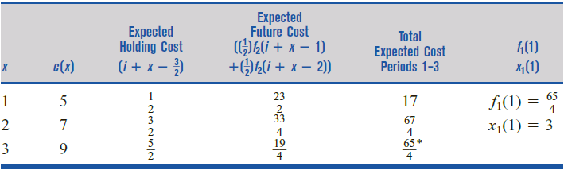
Probabilistic Inventory Model
f₁(i) = min_{x} {c(x) + i + x –1.5 + 0.5[f₂(i + x – 1) + f₂(i + x – 2)]
i
1
1
1
Demand Produce | Period 1 = 1 unit Period 2 = 1 unit | Period 1 = 2 units Period 2 = 2 units
Period 1 | 3 units | 3 units
Period 2 | 0 unit | 0 unit
Period 3 | 0 unit | 2 unit
Optimal action can’t be determined until the state at previous stage is known.

Slide 16
(s, S) Policies
optimal production policy : (s, S) inventory policy
The cost of producing x > 0 units during a period consists of a fixed cost K and a per-unit variable production cost c.
With a probability p(x), the demand during a given period will be x.
A holding cost of h per unit is accessed on each period’s end inventory. If we are short, a per-unit shortage cost of d is incurred.
The goal is to minimize the total expected cost incurred during periods 1,2,…,T.
All demands must be met by the end of the period T.

Slide 17
(s, S) Policies
For an inventory problem, Scarf used dynamic programming to prove that there exists an optimal production policy of the following form:
For each t (t = 1,2,…T) there exists a pair of numbers (s_{t} , S_{t}) such that if i_{t-1} (the entering inventory for period t) < s_{t} (demand), then an amount S_{t} − i_{t-1} is produced; if i_{t-1} ≥ s_{t} , then it is optimal not to produce during period t.
Notes:
S_{t} = production number
s_{t} = demand

Slide 18
Probabilistic Dynamic Programming Formulations
Probability that the next period’s state will be j, given that the current state ( at stage t) is i and action a is chosen

Slide 19
Markov Decision Processes
Horizon length (number of periods), T
Methods to solve unbounded expected rewards over an infinite horizon:
1. M + Mβ + Mβ² + … =
We can discount rewards (or costs) by assuming that $1 reward received during the next period will have the same value as a reward of β dollars (0 < β <1) received during the current period. This is equivalent to assuming that the decision maker wants to maximize expected discounted reward, M. Then the formula is maximum expected discounted reward that can be received over an infinite period horizon.
The decision maker can choose to maximize the expected reward earned per period. Then he or she would choose a decision during each period in an attempt to maximize the average reward per period.
Infinite horizon probabilistic dynamic programming problems are called Markov decision processes (or MDPs).
Notes:
Suppose a decision maker’s goal is to maximize the expected reward earned over an infinite horizon.
In many situations, the expected reward earned over an infinite horizon may be unbounded.

Slide 20
Markov Decision Processes
An MDP has
1. A set of state, S = {1, 2, …, N}
2. A set of actions (Decision), A = {1, 2, …, M}
A Transition probabilities function
4. A set of rewards, r = {1, 2, …, N}

Slide 21
Markov Decision Processes
For every MDP, there exists an optimal policy.
It’s a policy such that for every possible start state, there is no better option than to follow the policy.
A policy δ is a stationary policy if whenever the state is i, the policy δ chooses (independently of the period) the same decision (call this decision δ(i)).
If a policy δ* has the property that for all i ∈ S V(i) = V_{δ*}(i) then δ* is an optimal policy.

Slide 22
Applications of MDP
Robot path planning
Travel route planning
Elevator scheduling
Bank customer retention
Autonomous aircraft navigation
Manufacturing processes
Network switching & routing

Slide 23
optimal stationary policy
Policy iteration
Linear programming
Value iteration, or successive approximations

Slide 24
Policy Iteration
Value Determination Equations
Before we explain the policy iteration method, we need to determine a system of linear equations that can be used to find V_{δ}(i) for i ∈ S and any stationary policy δ.
The value determination equations
Howard’s Policy Iteration Method
We now describe Howard’s policy iteration method for finding an optimal stationary policy for an MDP (max problem).

Slide 25
Policy Iteration
Step1: Policy evaluation – Choose a stationary policy δ and use the value determination equations to find Vδ(i)(i=1,2,…,N).
Step 2: Policy improvement – For all states i = 1,2,…, N, compute
In a minimization problem, we replace max by min.
The policy iteration method is guaranteed to find an optimal policy for the machine replacement example after evaluating a finite number of policies.

Slide 26
Linear Programming
It can be shown that an optimal stationary policy for a maximization problem can be found by solving the following LP:
For a minimization problem, we solve the following LP:

Slide 27
Linear Programming
The optimal solution to these LPs will have V_{i} = V(i). Also, if a constraint for state i and decision d is binding, then decision d is optimal in state i.

Slide 28
Value Iteration
There are several versions of value iteration.
We discuss for a maximization problem the simplest value iteration scheme, also known as successive approximation.
Let V_{t}(i) be the maximum expected discount reward that can be earned during t periods if the state at the beginning of the current period is i. Then

Slide 29
Maximizing Average Reward per Period
We now briefly discuss how linear programming can be used to find a stationary policy that maximizes the expected per-period reward earned over an infinite horizon.
Consider a decision rule or policy Q that chooses decision d∈D(i) with probability q_{i}(d) during a period in which the state is i.
A policy Q will be stationary policy if each q_{i}(d) equals 0 or 1.

Slide 30
Maximizing Average Reward per Period
To find a policy that maximizes expected reward per period over an infinite horizon, let π_{id} be the fraction of all periods in which the state is i and the decision d ∈D(i) is chosen.
Then the expected reward per period may be written as

Slide 31
Maximizing Average Reward per Period
Putting together our objective function shown on the previous slide and all the constraints yields the following LP:

Slide 32
Policy Iteration & Value Iteration:
Which is best ???
It depends.
Lots of actions? Choose Policy Iteration
Already got a fair policy? Policy Iteration
Few actions, acyclic? Value Iteration
Best of Both Worlds:
Modified Policy Iteration [Puterman]
…a simple mix of value iteration and policy iteration
3rd Approach
Linear Programming

